Slide 1


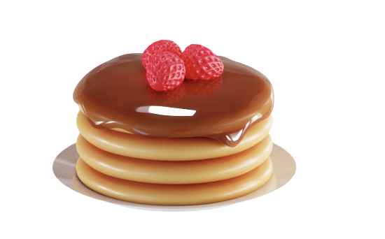

TUtasty - Iteration 2
Ann Kathrin Raible, Maja Schuknecht, Xinyi Miao
23/11/2022
Interaction Prototyping /

Slide 2

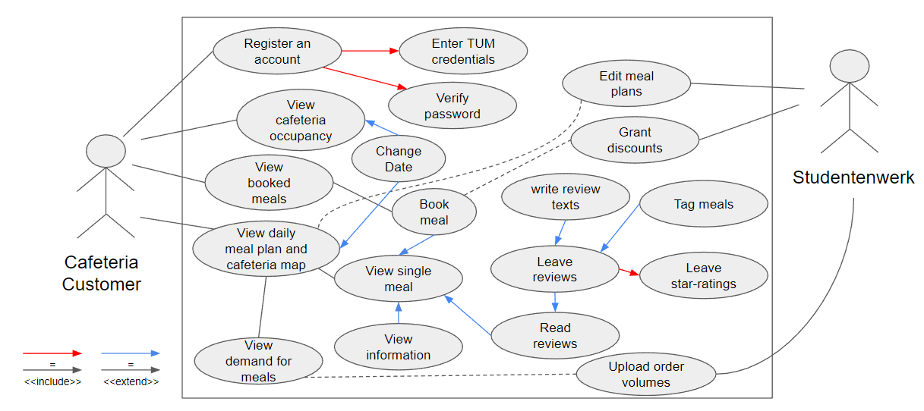
UML use-cases
Interaction Prototyping /
1

Slide 3
Requirements and usability goals
Usability Requirement “Users want to…” | Functionality “This is accomplished through (a/an)…”
1. Quickly see what is being served and where to find it | Overview of meal options and a map of counters, where selected meals are highlighted
2. Avoid bad-tasting meals / eat tasty meals | Average rating score of a meal List of other users’ reviews of a meal Review option that includes a star rating, tags and a description Images of the meal
3. Avoid long queues | Occupancy graph with predicted data Colour code for the counters that signifies expected queue lengths
4. Know a meal’s ingredients | Icons that symbolise common meal types (vegan, vegetarian, meat, fish) List of a meal’s ingredients List of a meal’s allergens
5. Avoid wasting food | [same as 2.] Tool that allows users to book meals a week in advance and get a discount upon purchasing them List of all booked meals that allows for easy cancellation
6. Save money | meal’s price Tool that allows users to book meals a week in advance and get a discount upon purchasing them
Interaction Prototyping /
2

Slide 4
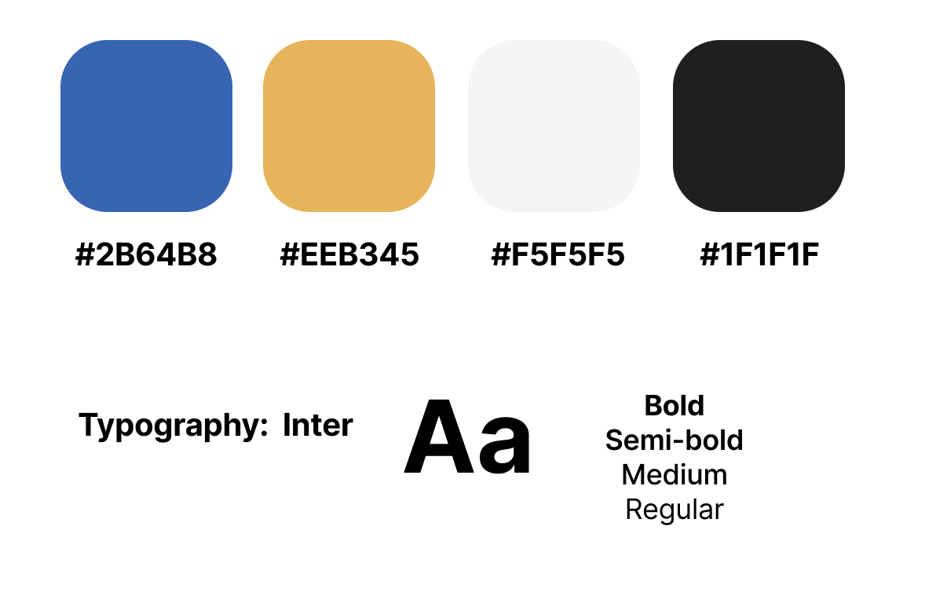
Visual Design
Logo :
Style Guide :
Contrast Ratio : 5.76 : 1 (Conforms to ISO 9241-303)
Interaction Prototyping /
3

Slide 5
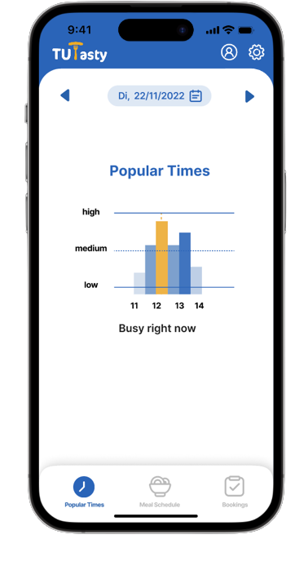
HIFI prototype
Click to jump to figma
Interaction Prototyping /
4

Slide 6
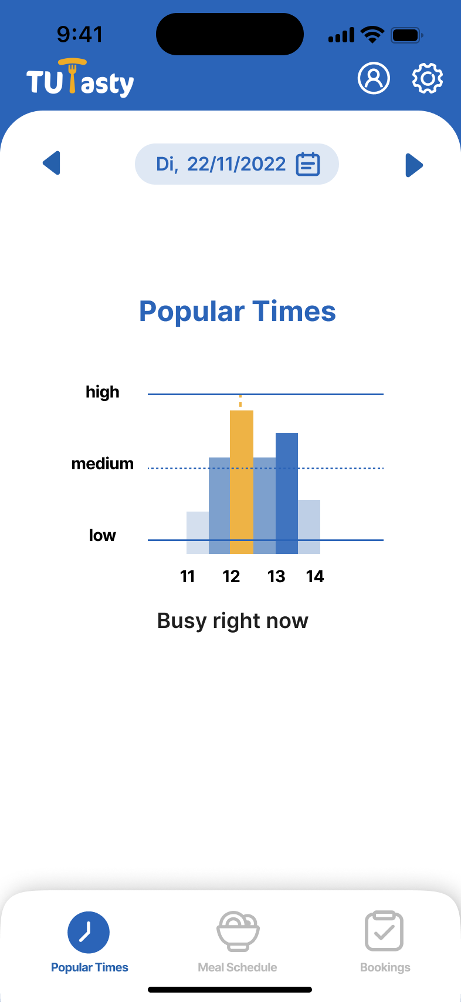
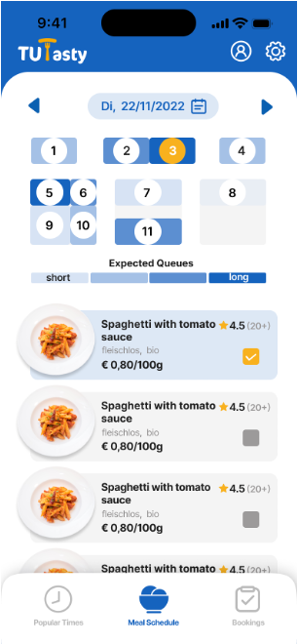
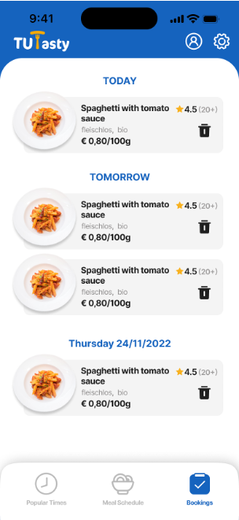
HIFI prototype
Interaction Prototyping /
5

Slide 7
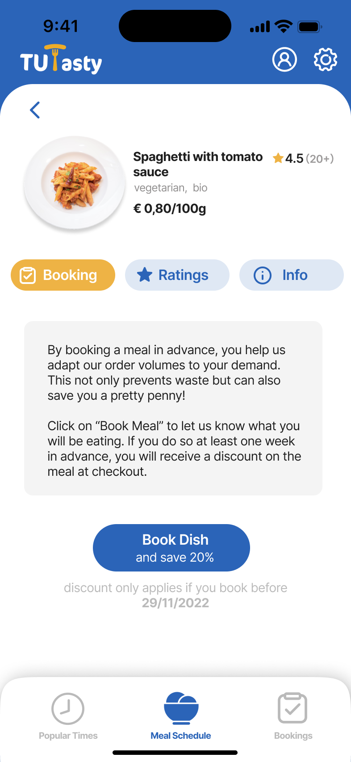
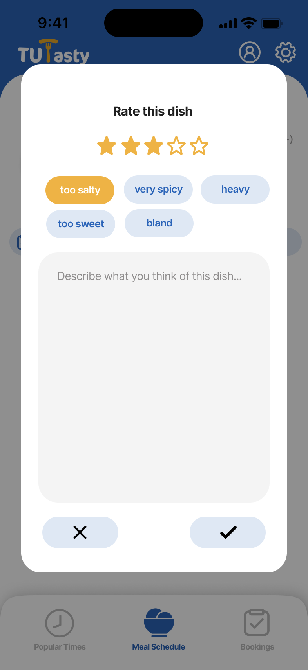
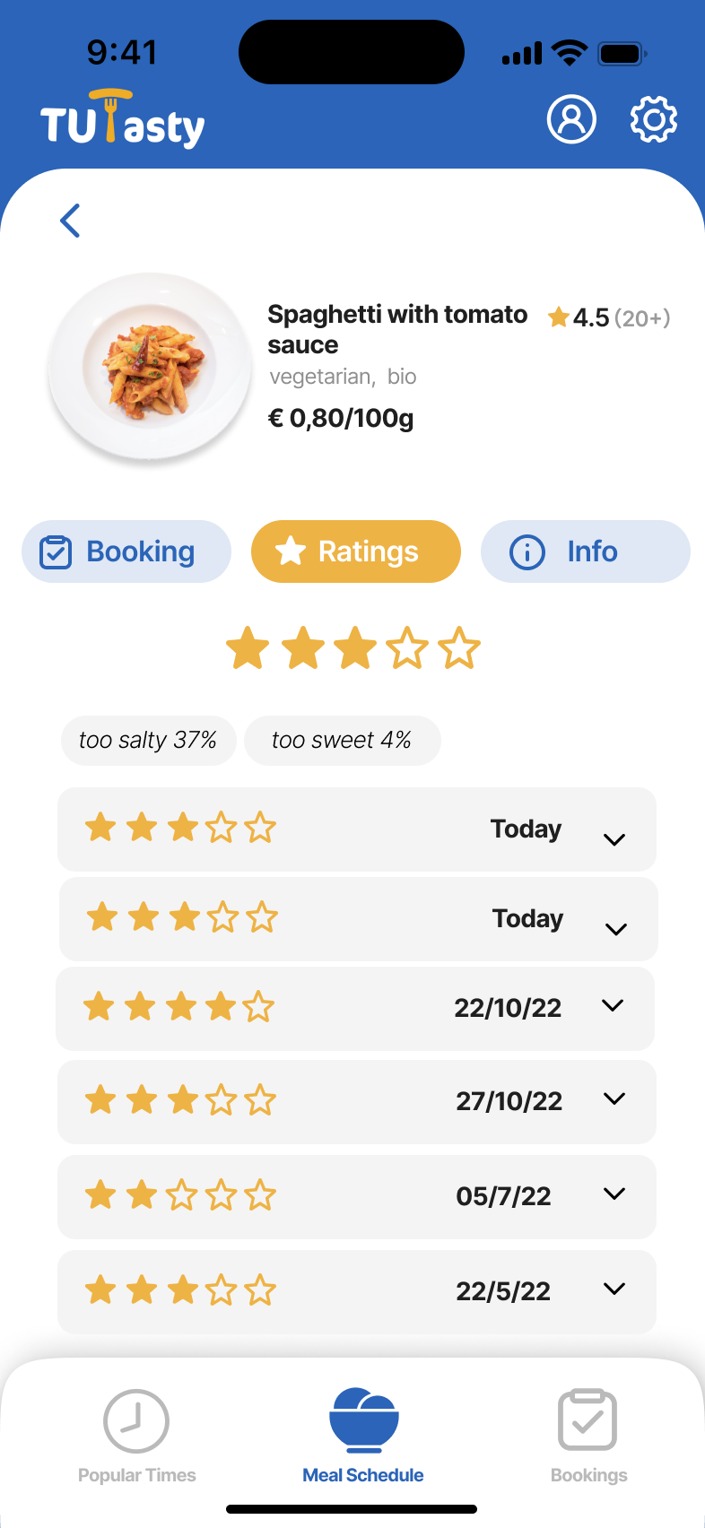
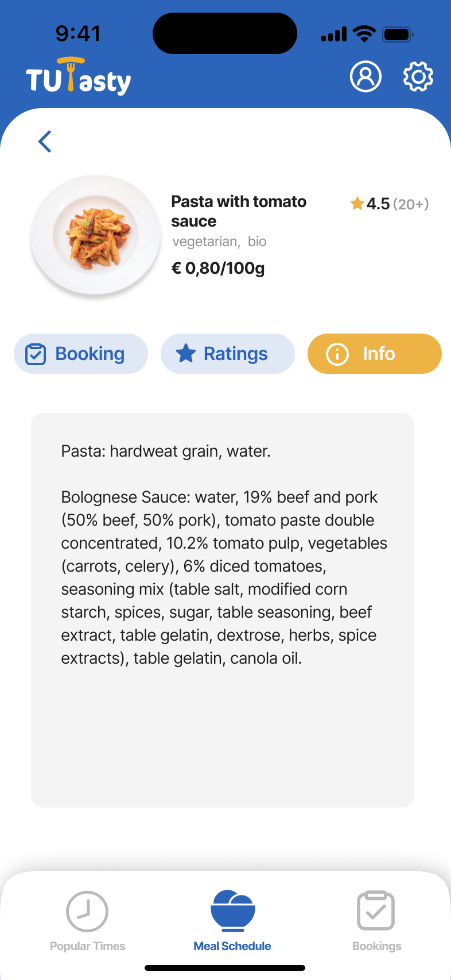
HIFI prototype
Interaction Prototyping /
6

Slide 8
Heuristic Evaluation
Feedback: There is no information on the exact waiting time, add the exact time.
Reflection: Technically not possible, would lead to inaccurate information
Feedback: Numbers are confusing, add information what "Expected Queues" means, screen is very complex and should be split
Reflection: Numbers will be removed or reworked, splitting screen reduces efficiency of use
Interaction Prototyping /
7

Slide 9
Heuristic Evaluation
Feedback: Highlight relevant allergens or raw materials
Reflection: Users will be able to input relevant ingredients on registration, marked bold on screen
Feedback: Users are more interested in the average performance than specific daily ratings
Reflection: more prominent visualization of average
Interaction Prototyping /
8

Slide 10
Evaluation: Questions
Visibility of system status
"The hashtags of the exact dish are not clear/ remind users of the specialness of the dish through prominent colors and bold fonts"
Aesthetic and minimalist design
"Use a line chart to replace the current interface and provide the average score for each quarter of this dish"
Interaction Prototyping /
9

Slide 11
Thank you for your attention!
Interaction Prototyping /

